Slide 1
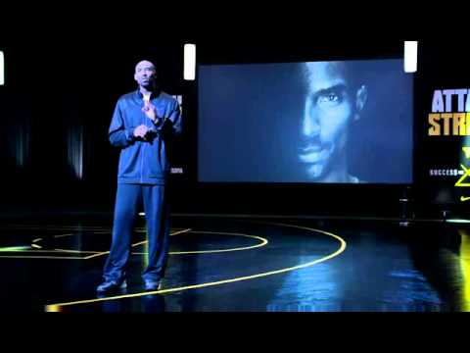
“A different animal, same beast.”
Notes:
Play Video - 30 secs

Slide 2


Samual Prutton
Aruna Bisht
Matheus Araujo
Edgar Coronado
STEADY ANALYZING MARKET ENVIRONMENTS
Notes:
Intro - Edgar - 1 minute
Good Evening Everyone!
We are SAME, a PropTech startup disrupting the way real estate investing is done. The world that we live in is changing, and with change comes great responsibility. Responsibility that requires innovation, which is the core of our business model. Aside from SAME being the initials of our founders, we Steadily Analyze Market Environments, that’s what we do, and do that through various data points and technology. To stand out from our competition, we’re able to make recommendations to our users based on their lifestyle and their financial goals. It’s what makes us a different animal, and the same beast.
Concept/Motivation
The pandemic has had an unprecedented impact on the choices we make as individuals, specifically financial choices. Recent events with Gamestop and Robinhood are a great example of that. We’ve transitioned into an information era, so our motivation is to leverage our data-driven business model to educate our users, by providing them the research and analysis needed to decide whether they should buy, sell, or rent out a property.
Transition statement - With that being said, I’ll introduce Aruna so she can discuss our user story and our market approach.

Slide 3

VISION
Notes:
User Story - Aruna - 45 secs
As a user, let’s say that my lease is up and my company has gone fully remote, giving me the flexibility to move anywhere in California. I’ve always lived in San Francisco, so I’m not aware of what other cities have to offer. I’d like to find the city that best fits my lifestyle but also makes the most financial sense for me.
That’s what our app does, we first analyze our user’s lifestyle, we want to be intentional with our recommendation and ensure that they invest in a city that they’re happy to live in. We then analyze our user’s financial goals, we want to make sure that makes financial sense for them. Depending on timing, pricing, and supply and demand, we will make the recommendation of which city is the best for them to invest in.
Transition statement - So well speaking of protype I would handover to Mathew, who will talk about technologies we have used to develop this prototype.

Slide 4

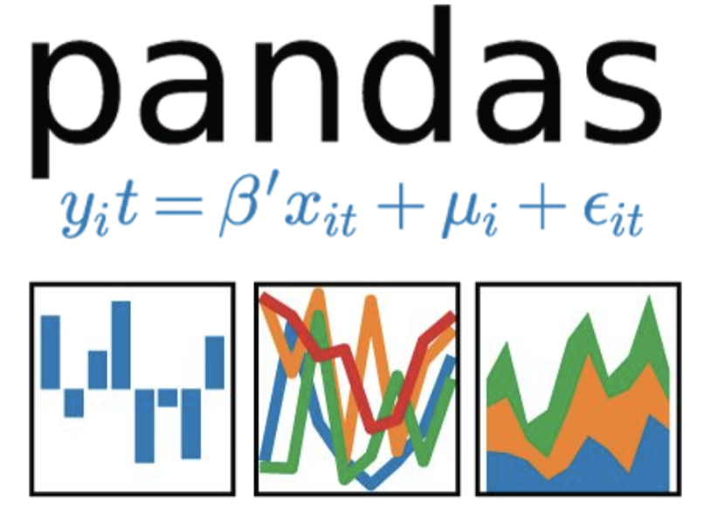
The Process
Technologies Used:
Python
Pandas
Jupyter Notebook
Matplotlib
NumPy
Pyviz
HvPlot
HTML, CSS & Javascript
AWS
The MapBox API
GitHub
VS Code
Data Sources:
Realtor API
US Census Bureau API
California API
New Python Library:
Flask
Notes:
Technologies & Data Used - Matheus - 45 secs
In order to make our recommendations, you see the various technologies that we use to ensure we have a quality application, such as Pandas to clean and format our dataset, Jupyter Notebook to describe the data exploration process, PyViz and MapBox for visualizations, as well as Flask, which is a new library that we learned from creating this project. In order to obtain our data, we leveraged Realtor API, US Census API, California API, and Covid data
Through these API’s, we were able to obtain various information, such as number of properties sold in the last year, number of properties currently on the market, average current rent per city, average population, average COVID cases, average income, amongst other factors.
Transition Statement - Now, I’d like to introduce Samual, who can talk to us about how we leveraged this technology to create our free app version.

Slide 5

Free App Version
Notes:
Free App Version - Samual - 1 minute
Our current version, allows our users to decide on the city that best fits their lifestyle and investment needs. Users will be able to determine which cities are currently experiencing a buyer’s market, a seller’s market, and which cities would be best if they’d like to rent out their home. This allows us the ability to provide general trends within top cities in California. The markets are determined by the following:.
Buyer’s Market - Should you buy?
When supply exceeds demand. There are less buyers, but a lot of inventory. Homes are not selling and sellers are pushing prices down to get rid of the property.
Monthly Cash Flow Generator - Should you buy to rent?
This is where most of our users will look to analyze their investment, and where we provide analysis of the average rent income they can expect to receive from their property, depending on the city.
Seller’s Market - Should you sell your home?
When demand exceeds supply. There are many interested buyers, but low inventory. Homes are selling fast and buyers are competing with each other, pushing the property prices up.
Transition Statement: Now, Edgar will discuss our Premium App, which is what we will continue to implement as we grow our startup

Slide 6

Premium App Version
Notes:
Premium App Version - Edgar - 1 minute
As Samual stated, due to the early stages of our startup, our current market is tailored to CA residents, and just like any other startups, we ran into some limitations, such as not having enough data points for all the cities in California, i.e. tax rates, cap rates for rental properties, and other factors that we will be considering. So what we did is, we chose 10 cities for now, which include 5 metropolitan cities, and 5 tropical cities. Our goal is to have a Free Version that will showcase everything that Samual just went over, but also a Premium Version, where we can take those limitations and turn them into our competitive advantage going forward. So here’s how:
Access to the Real Estate Marketplace
Allows users to connect with virtual Real Estate agents, who have access to buyers, sellers, and renters in the community.
These agents will guarantee that our users have either a buyer or a renter for their home if they do business with us. If there’s no one on the other side of the transaction, then there’s no deal. This will allow us to build trust with our customers.
Cash Flow Predictor
Specific to individual Homes - Allowing users to take in actual taxes, insurance, and other costs to find out exact operating income, instead of city averages. Because they will be connected with our agents, they’ll know this in advance before closing the deal.
Transition Statement - Okay, so enough talking for me, let’s turn our focus to the visual learners in the class. Samual, take it away.

Slide 7
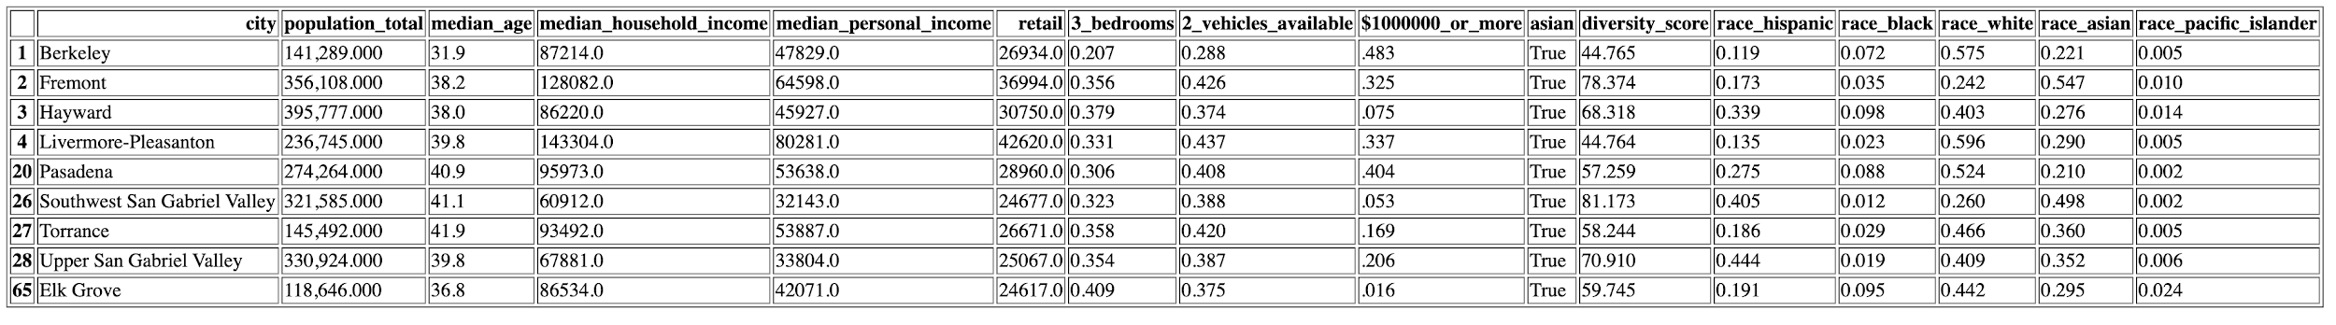
Lifestyle Results
Notes:
Samuel - 30 secs
Transition to Aruna

Slide 8
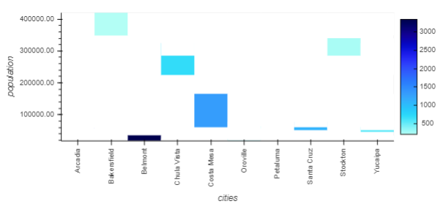
Housing Prices & Population Correlation
Notes:
Aruna - 30 secs
During our analyzation we focused on most critical factors which affects the demand and supply and hence housing market prices.
Well as my team said that we tested this on protype and hence with less data this is what our heat map looks like. So speaking of factor, this heat map shows that
Bakersfield - large population, but cheap prices = if you want to rent it out, you won’t make as much profit
Costa Mesa - smaller city but more dense, prices are higher = more profit
Talk about these are the parameters that we’re analyzing the scenes to make a recommendation
Transition statement - similarly other factors

Slide 9
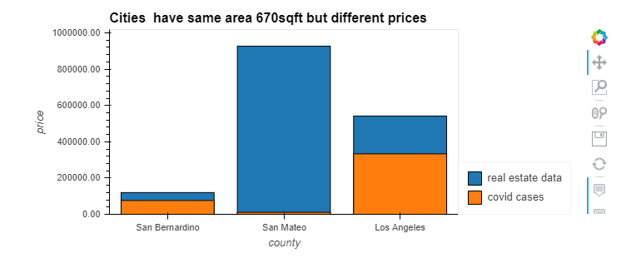
Housing Prices & Covid Correlation per Sq Ft.
Notes:
Aruna - 30 secs
Low covid cases but so high housing price
LA - 235,312 employees from top 100 companies, employment
Transition statement - speaking of cities, now I will handover to Mathew who will talk about overall California population statistics which has affected real estate market

Slide 10
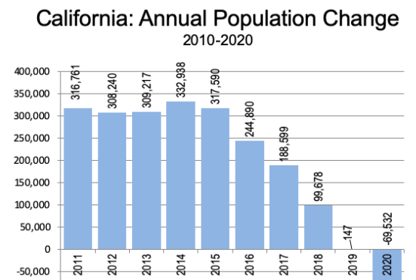
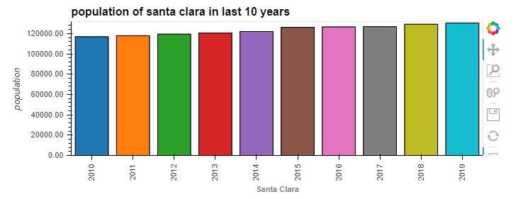
Notes:
Matheus - 30 secs
The Census Bureau published its 2020 California state population estimates, which indicate that the state that has led growth in the United States for the last 170 years lost 70,000 residents last year.
For the first five years of the decade, California had gained 300,000 residents, with a total gain over the period of 1.6 million. Since 2015, California’s population gain plummeted, reaching virtually zero in 2019 and the loss in 2020 (Figure 1). At the same time, the Census Bureau restated California’s 2018 to 2019 population change, which had been shown as a gain of 51,000 last year to a gain of only 147.
Transition to Samuel

Slide 11
Prototype Demo - Lifestyle
Notes:
Demonstrate app usage with predetermined inputs. - Samual - 1 Minute
Transition to Aruna -

Slide 12
Prototype Demo - Financial
Notes:
Demonstrate app usage with predetermined inputs. - Aruna - 1 Minute

Slide 13

FUND OUR PROPTECH
Notes:
Edgar - 30 secs
As you can see, our analysis is unique and our business model has huge potential for growth. In order to expand and release our Premium Version, we are asking for you to be a part of this journey. Knowledge is key. Which is why we are seeking a $250,000 (or 5 bitcoins) investment for 10% stake in our company, allowing us to give our customers the key to investing in real estate, or the key to their next home. With your investment, we will be able to hire a data scientist and a software developer in order to bring this product to life. We will then go out to market with a business development officer in order to create our marketplace presence and advertise our business. Our goal is to bring real estate investing awareness to the people.
There’s a lot of investors in here, but are you a different animal, and the same beast?

